Slide 1
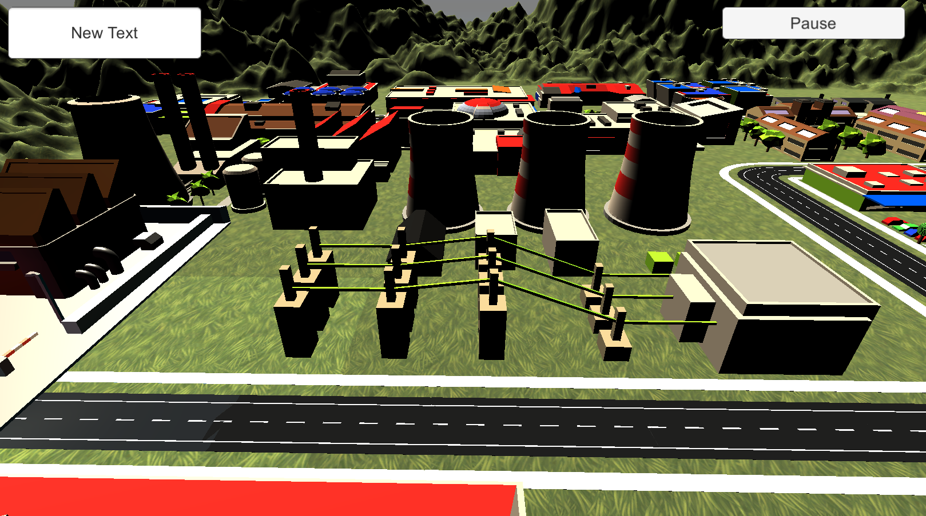
Player: Sam Score: 500
Question Title
1st pos answer
1st pos answer
3rd pos answer
2nd pos answer
2nd pos answer
3rd pos answer
Confirm

